Slide 1
Outlines
Registers and Counters:
  What are they?
Registers:
  Registers with Parallel Load
  Shift Registers
  Serial Adders
Registers
and
Counters

Slide 2
Registers
Group of D-F/Fs
Synchronized (One CLK)
Store data
I₀
D
Q
A₀
R
I₁
D
Q
A₁
R
I₂
D
Q
A₂
R
I₃
D
Q
A₃
CLK
R
Reset

Slide 3
Registers
I₀
D
Q
A₀
CLK
I₃
R
I₂
I₁
A₁
D
Q
I₁
R
I₀
A₃
I₂
D
Q
A₂
A₂
R
A₁
I₃
D
Q
A₃
A₀
CLK
R
Reset

Slide 4
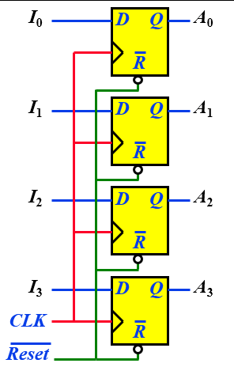

Register with Parallel Load
Requirement:
  Retain/Store old data (when ever desired)
  Control Loading the Register with new data
First Solution:
  If the contents of the register must be left unchanged, the inputs must be held constant
  The data bus driving the register would be unavailable for other traffic

Slide 5


Register with Parallel Load
LD | Q(t+1)
0 | Q(t)
1 | D
  Control the operation of register with D Inputs
  Use MUX and circulate ‘Old Data’
MUX
I₀
I₁
Y
D
Q
A₀
I₀
S
MUX
I₀
I₁
Y
D
Q
A₁
I₁
S
MUX
I₀
I₁
Y
D
Q
A₂
I₂
S
MUX
I₀
I₁
Y
D
Q
A₃
I₃
S
Load
CLK

Slide 6
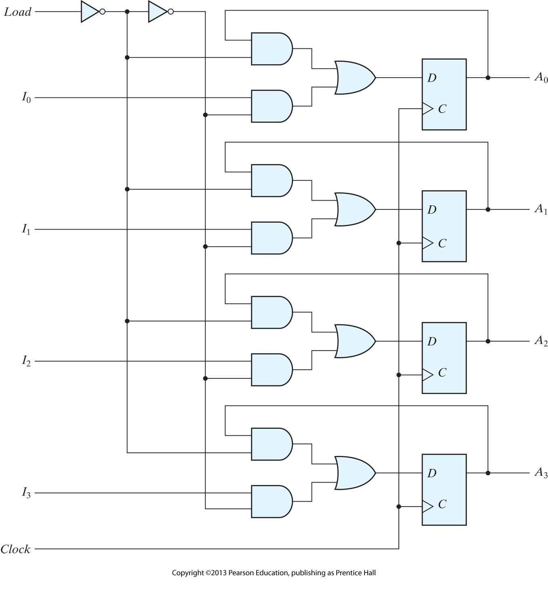
Register with Parallel Load

Slide 7
Shift Registers
What are they?
  A register capable of shifting the binary info. held in each cell to its neighboring cell, in a selected direction
Construction:
  Consists of a chain of F/Fs in cascade
  All F/Fs receive common CLK pulses to activate shift
Serial
Input
SI
SO
D
Q
D
Q
D
Q
D
Q
Serial
Output
CLK

Slide 8
Shift Registers
Q₃
Q₂
Q₁
Q₀
SI
D
Q
D
Q
D
Q
D
Q
SO
CLK
CLK
SI
Q₃
Q₂
Q₁
Q₀

Slide 9
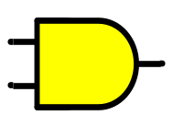
Serial Transfer Transfer
Scenario:
  Source Register (A) holds 1 (4-bit) value
  Which needs to be ‘copied’ in Destination Register (B)
  ‘Copied’ means Transfer into ‘B’ and Retain in ‘A’
For Transfer (A → B):
  Connect O/p of ‘A’ into I/p of ‘B’
  Synchronize both Registers with same Clock
  Clock can be ‘anded’ with Shift Control I/p
For Retain (A → A):
  Recirculate the O/p of ‘A’ as I/p of same register
SI
SO
SI
Shift Register A
Shift Register B
Clock
CLK
CLK
Shift
Control

Slide 10
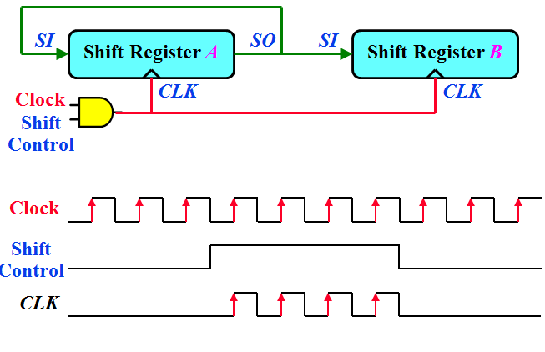
Serial Transfer
Data transfer one bit at a time
Data loopback for register A
Time
initial
T1
T2
T3
T4
Reg A
1011
1101
1110
0111
1011
Reg B
0010
1001
1100
0110
1011

Slide 11
Serial Adder
Scenario:
  Register A holds ‘Augend’
  Register B holds ‘Addend’
  Contents of A and B needs to be added serially
Design:
  Have a Full Adder (FA) (x + y + C_{in})
  Connect O/ps of A and B into FA
  What to do with Sum (S) and Carry (C) O/ps?
Shift Register A
FA
x
y
z
S
C
Shift Register B

Slide 12
Serial Adder
Carry (C) O/p:
  How to ‘feedback’ previous carry as next?
  C should also be synchronized together with Regs. A & B
  Remember, every component is synchronized with Clock
  So if somehow we manage to ‘attach’ C with Clock, it will get synchronized with clock or with Reg. A & B
  We can not connect Clock with FA (Combinational cct.)
  Solution: Add a F/F (Say D-type) to store C
Shift Register A
FA
x
y
z
S
C
Shift Register B
Q
D
CLR
Clear

Slide 13
Serial Adder
Sum (S) O/p:
  Result of summation can be stored in another Register (say D)
Shift Register A
FA
x
y
z
S
C
Shift Register D
Shift Register B
Q
D
CLR
Clear

Slide 14
Serial Adder
Sum (S) O/p:
  In case, contents of one of the input Registers (‘A’ or ‘B’) are no more required to be preserved
  ‘A’ can also be used to retain the result of Summation (previous data over-written)
  Re-circulate ‘S’ into ‘A’
SI
Shift Register A
FA
x
y
z
S
C
Shift Register B
Q
D
CLR
Clear

Slide 15
Serial Adder (First Form)
Adding Clock controlled with ‘ Shift I/p’
Shift
Control
SI
Shift Register A
FA
x
y
z
S
C
Shift Register B
CLK
With every clock pulse, one bit each from ‘A’ and ‘B’ goes into FA. Previous carry stored in F/F also gets in.
Q
D
CLR
Clear

Slide 16
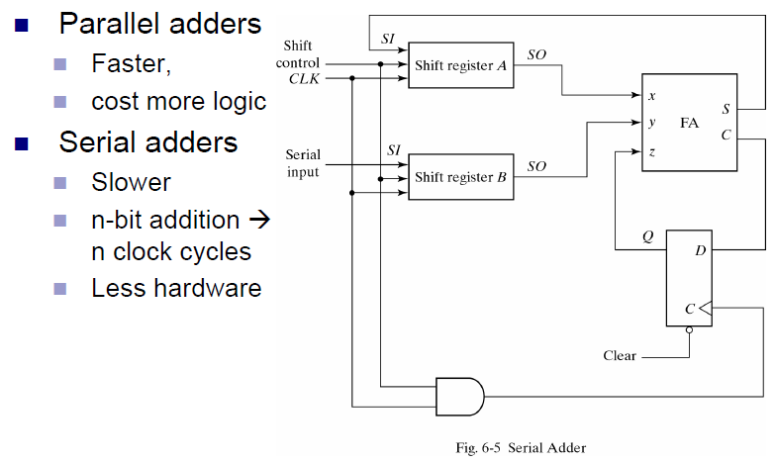
Serial Addition

Slide 17
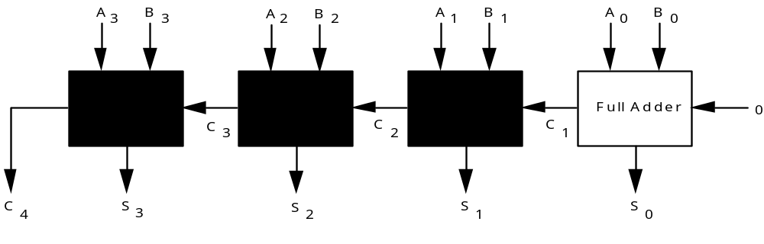
4-Bit Adder
Chain single-bit adders together.
C 1 1 1 0
A 0 1 0 1
B 0 1 1 1
S 1 1 0 0

Slide 18
Universal Shift Register
A₃
A₂
A₁
A₀
S₁
CLR
S₀
USR
SR_{in}
I₃
I₂
I₁
I₀
SL_{in}
Mode Control |  | Register Operation
S₁ | S₀
0 | 0 | No change
0 | 1 | Shift right
1 | 0 | Shift left
1 | 1 | Parallel load

Slide 19
Universal Shift Register
A₃
A₂
A₁
A₀
Q
Q
Q
Q
D
D
D
D
CLR
CLK
S₁
S₀
S₁
S₀
Y
MUX
3 2 1 0
SI for SR
SI for SL
I₃
I₂
I₁
I₀

Slide 20
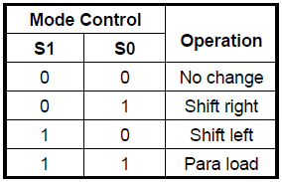

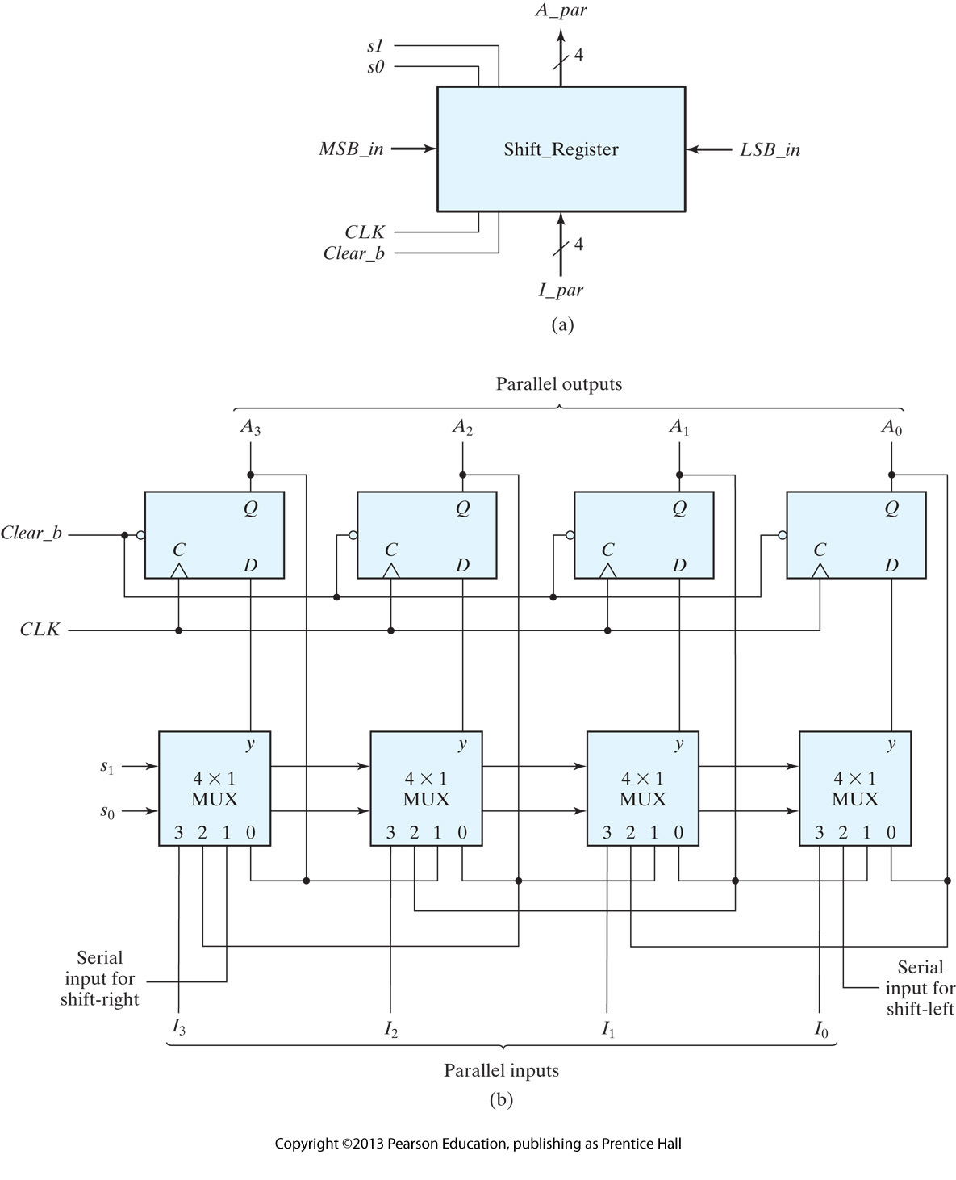
Universal Shift Register:

Slide 21
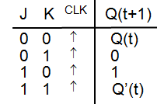

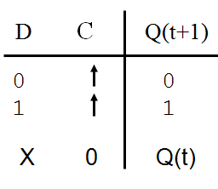
Complementing Flip Flops
The next state of these flip flops is complement of present state.
They can constructed using T, J-K and D flip flops.

Slide 22
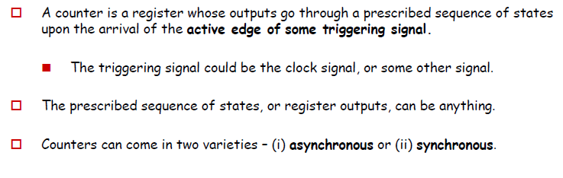
Counters:

Slide 23
Ripple Counter (asynchronous Counter)
Ripple counters consist of a series of flip-flops where the output Q of one flip-flop is used (somehow) as the clock for the next flip-flop.
It is the lack of a common clock signal for each flip-flop that makes the counter asynchronous.
Not all flops change value simultaneously
  Lower-order flops change first

Slide 24
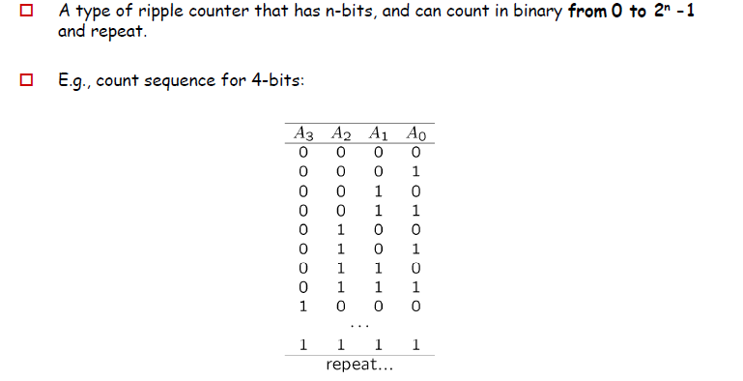
Binary Ripple Counter

Slide 25
Binary Ripple Counter
We can make a binary ripple counter easily via observation…
A₀ always flips…
A₁ flips with A₀ goes 1 to 0…
A₂ flips with A₁ goes 1 to 0…
Etc…
So, the i-th bit goes 1 to 0 , (i+1)-th bit flips.

Slide 26
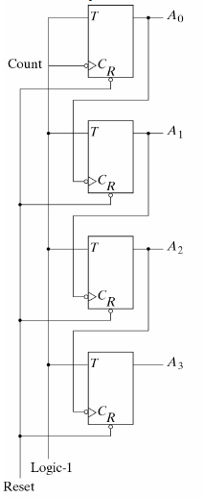
Binary Ripple Up Counter
Binary Ripple Counter with TFF

Slide 27
Binary Ripple Counter
If T=1,
Q(t+1) = Q’(t)
Ripple ↔ Asynchronous
A₃
A₂
A₁
A₀
Q
T
1
Q
T
1
Q
T
1
Q
T
1
CLK
CLR
CLR
CLR
CLR
CLR
CLK
A₀
A₁
A₂
A₃

Slide 28
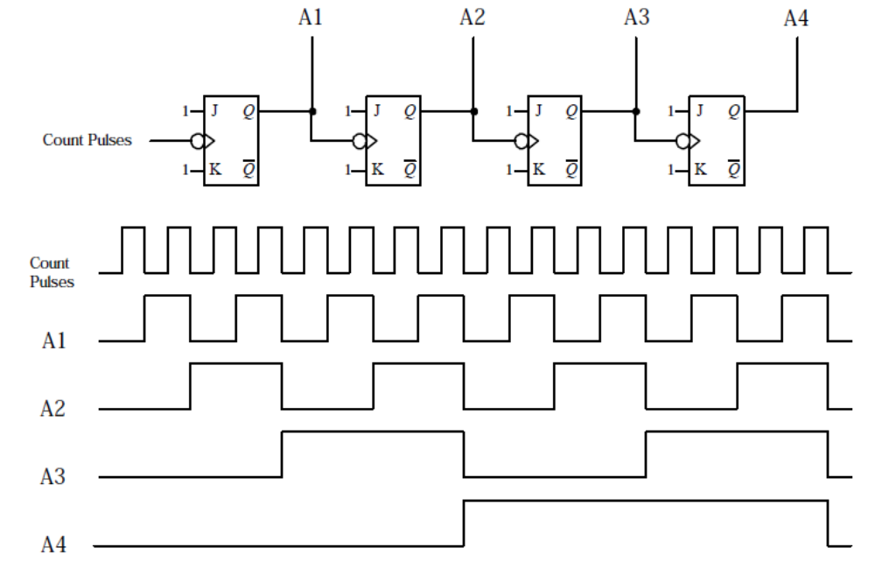
Binary Ripple Counter

Slide 29

Binary Ripple Counter
A₃
A₂
A₁
A₀
Q
D
Q
D
Q
D
Q
D
CLK
Q
Q
Q
Q
CLK
A₀
A₁
A₂
A₃

Slide 30
Binary Ripple Counter
A₃
A₂
A₁
A₀
Q
D
Q
D
Q
D
Q
D
CLK
Q
Q
Q
Q
CLK
A₀
A₁
A₂
A₃
0
1
2
3
4
5
6
7
8
9

Slide 31
Binary Ripple Down Counter
BINARY UP COUNTERS:
A counter that counts 0, 1, 2, L , 2^{n}-1 and repeats.
BINARY DOWN COUNTERS:
A counter that counts 2^{n}-1, L , 2, 1, 0 and repeats.
In down counter:
A₀ always flips…
A₁ flips with A₀ goes 0 to 1…
A₂ flips with A₁ goes 0 to 1…etc.
So binary ripple down counter diagram looks like same as binary ripple up counter diagram (shown in previous slides) provided all flip flops are positive edge trigerred.

Slide 32
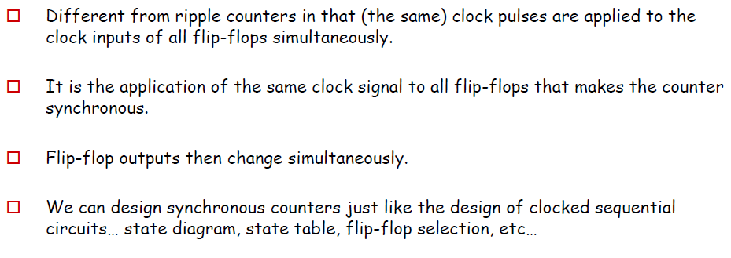
Synchronous Counters

Slide 33
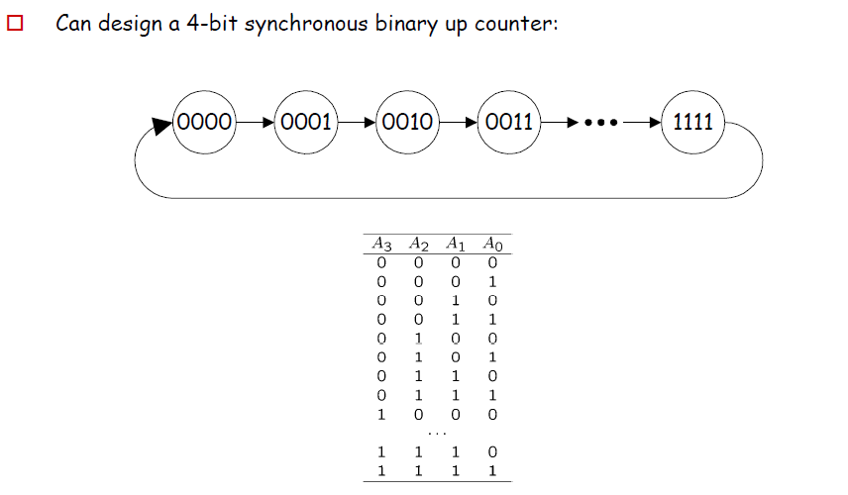
Synchronous Binary Counter-Up Counter

Slide 34
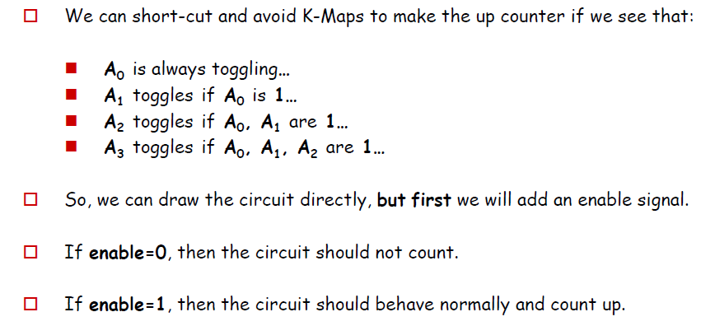
Synchronous Binary Counter-Up Counter

Slide 35
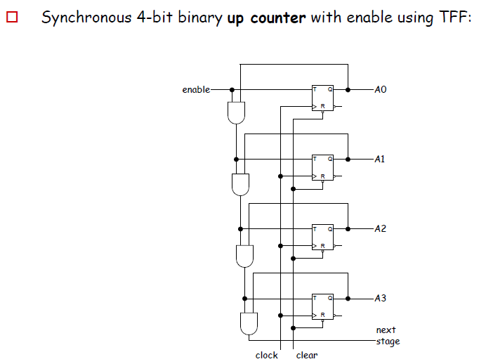
Synchronous Binary Counter-Up Counter

Slide 36
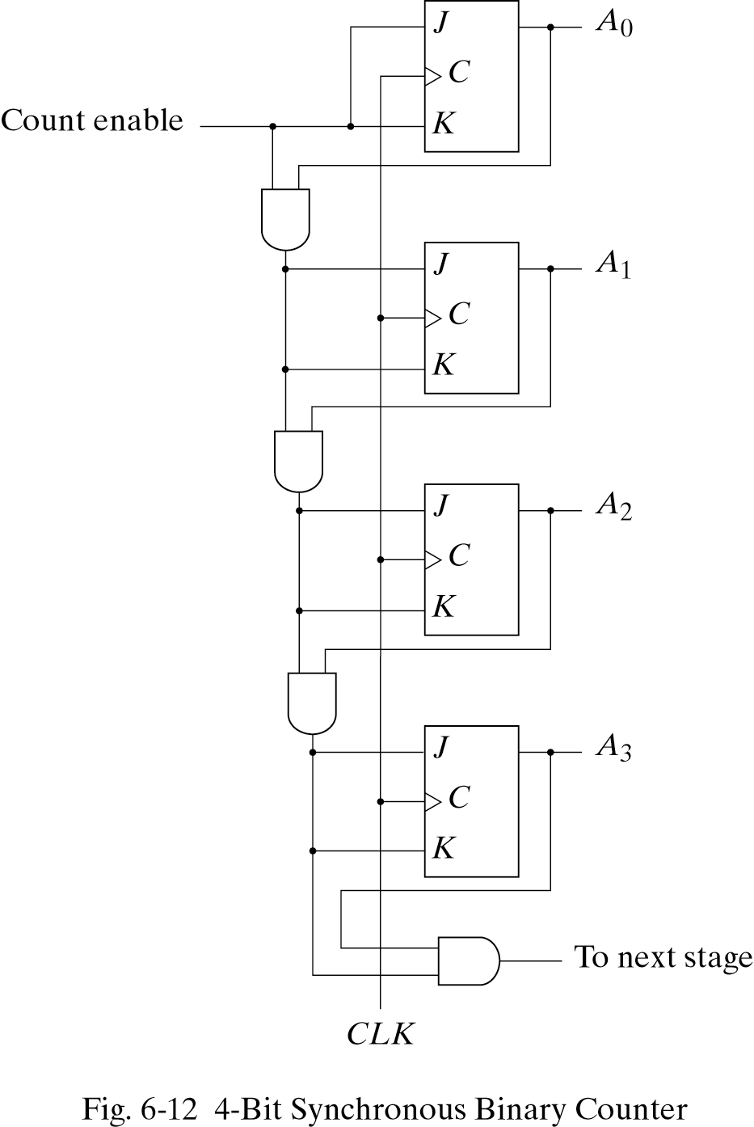
Synchronous Binary Counter-Up Counter
Designed with JK FF

Slide 37
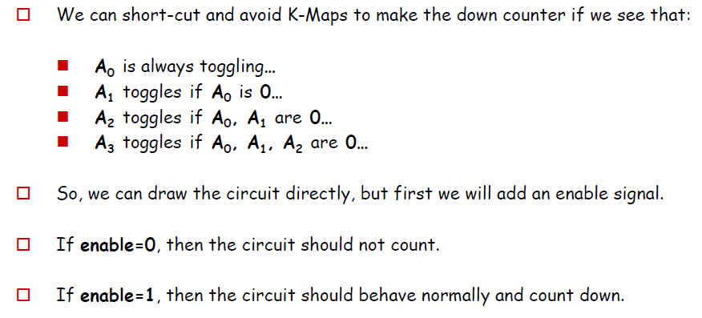
Synchronous Binary Counter-Down Counter

Slide 38
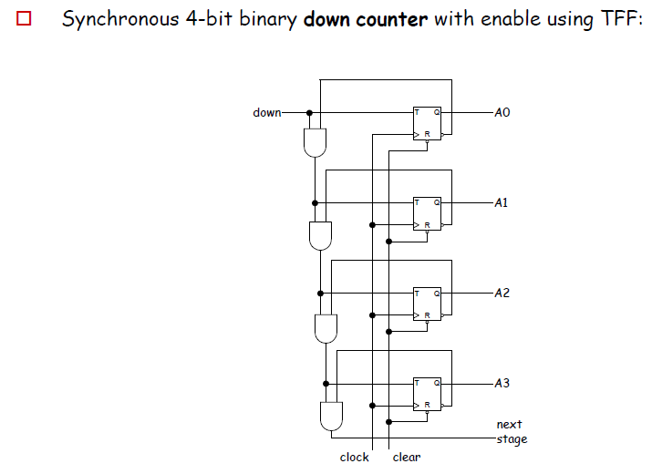
Synchronous Binary Counter-Down Counter

Slide 39
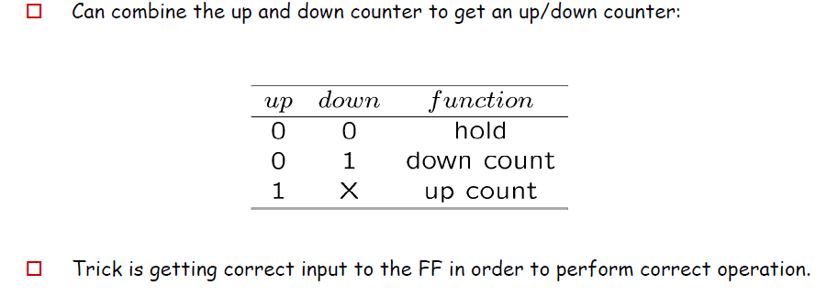
Synchronous Binary Counter-Up/Down Counter

Slide 40
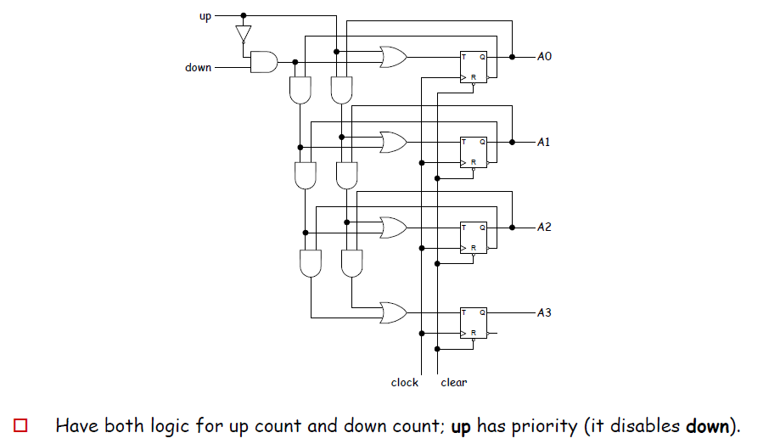
Synchronous Binary Counter-Up/Down Counter

Slide 41
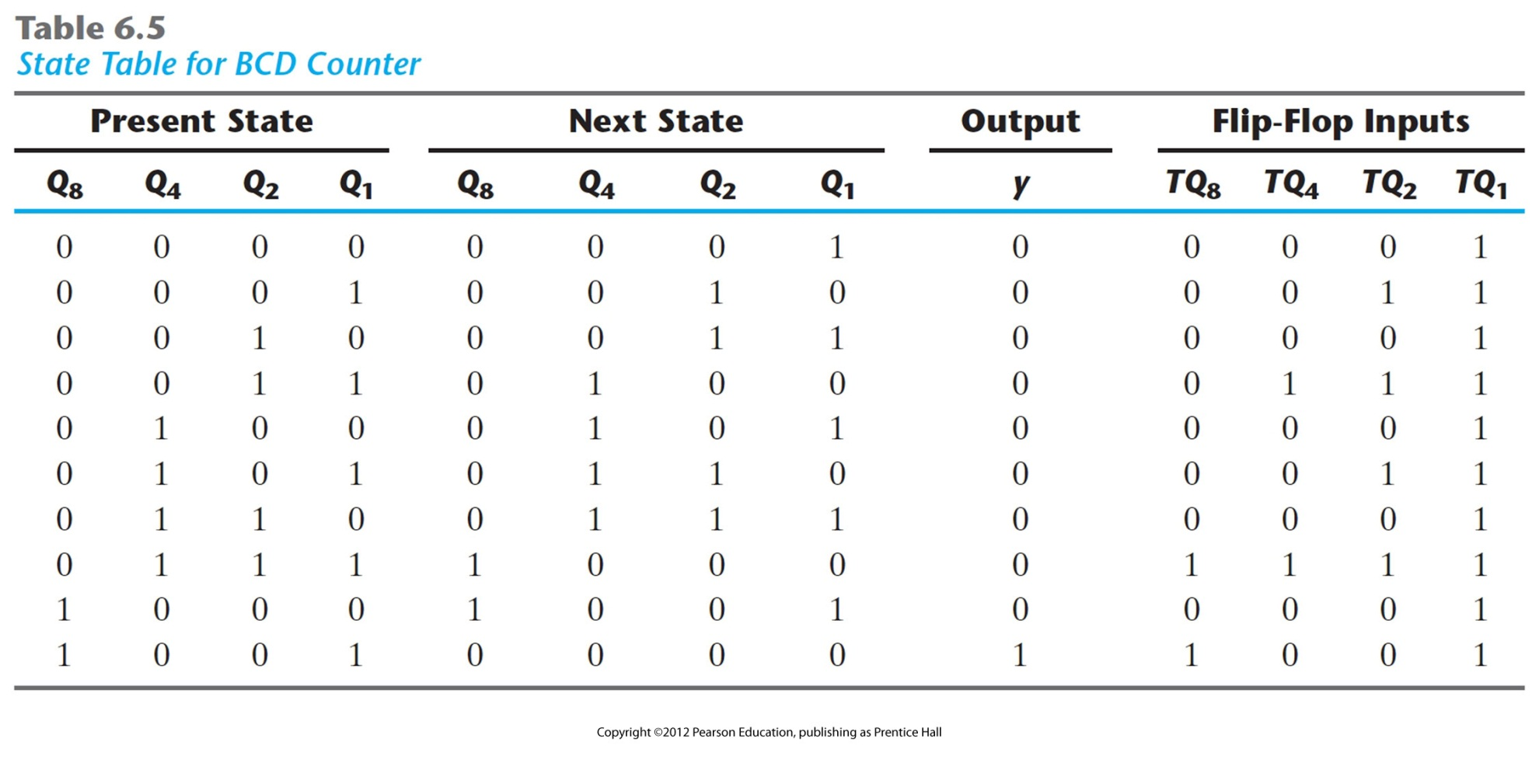
BCD Counter (Using Usual Approach)
State Table

Slide 42
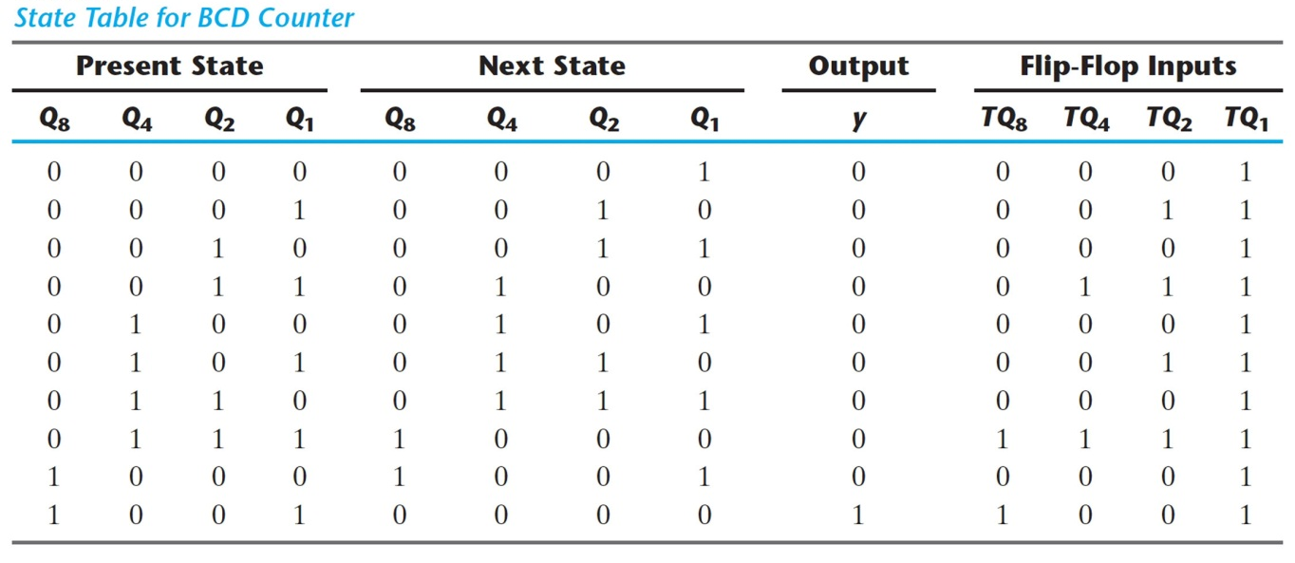
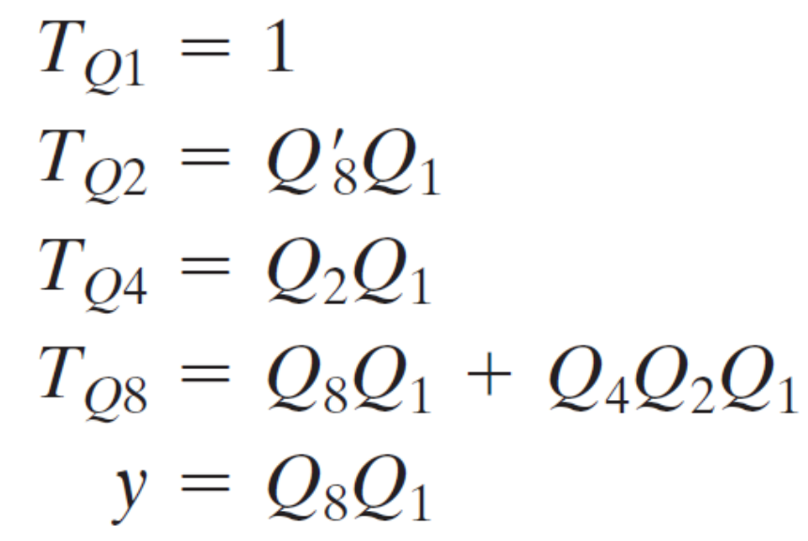
BCD Counter (Using Usual Approach)
Write F/F I/p Equations (Using Excitation Table)

Slide 43
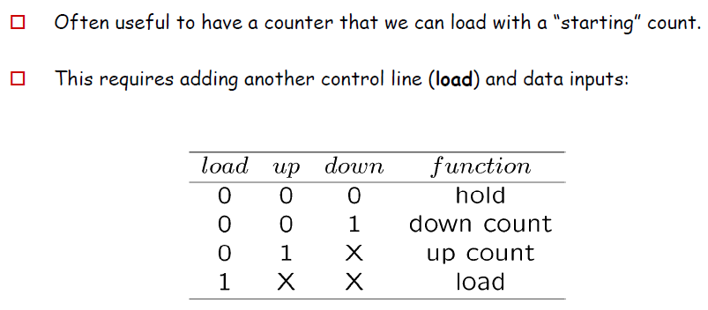
Binary Counter with Parallel Load

Slide 44
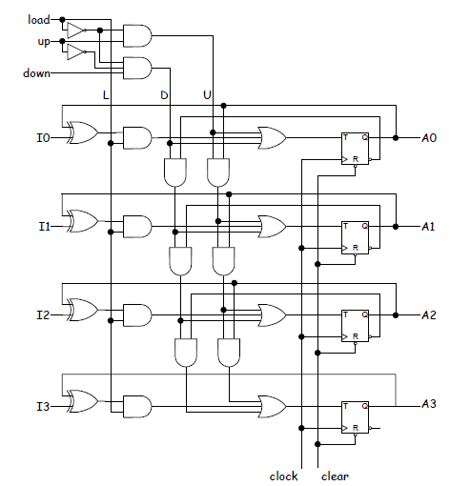
Binary Counter with Parallel Load
Designed with TFF

Slide 45
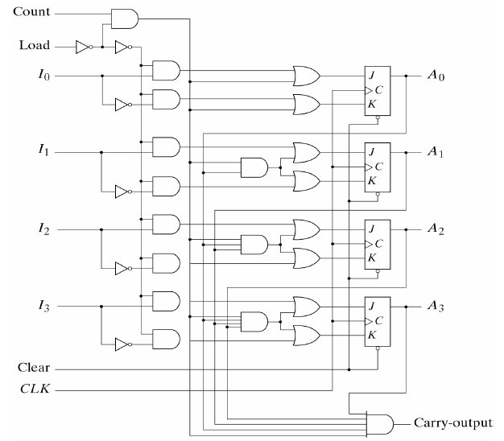
Binary Counter with Parallel Load
Designed with JK FF

Slide 46
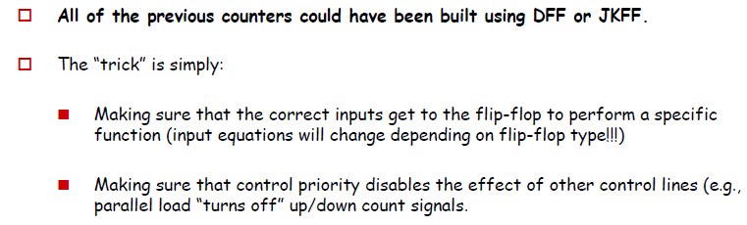
Comments:

Slide 47
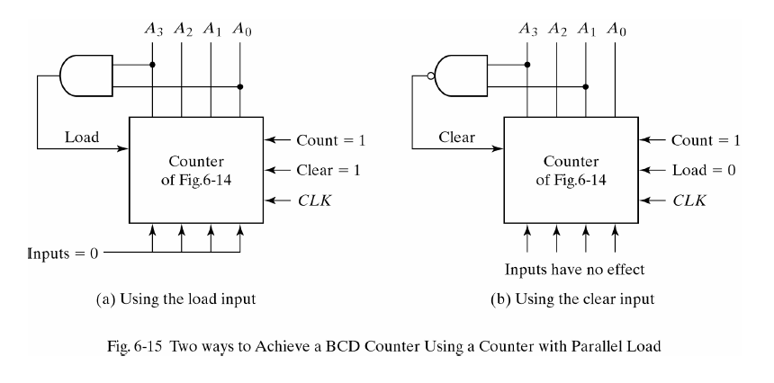
BCD Counter and Modulo N Counter

Slide 48
Counter with Unused States
Often we will have an n-bit counter that does not count through all 2^{n} possible values/ states.
In this case, there will be unused states (unused output patterns).
Strategy - I:
  Treat them as Don’t Care conditions (X)
Caution:
  The circuit may happen to go in any unused state (due to interference or external disturbances)
  A MUST check after the final design is ready
  We need to make sure that unused state → leads (back) to the proper states
  If not, go to Strategy - II

Slide 49
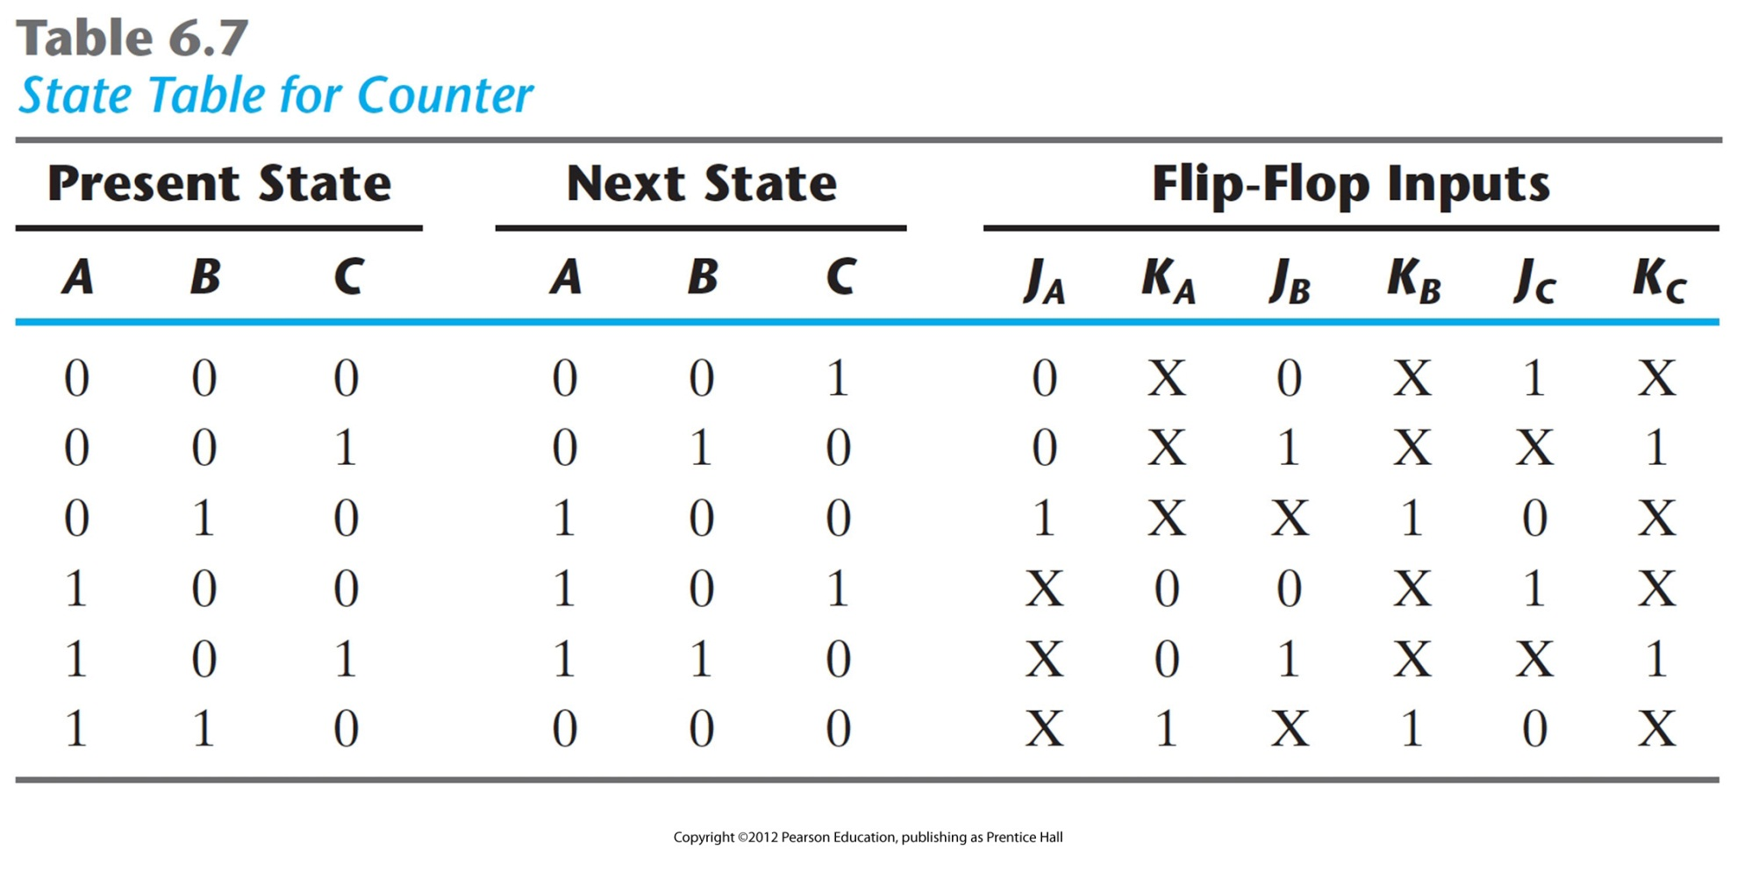
Counter with Unused States
000
001
110
010
101
100
Two Unused States:
011
111

Slide 50
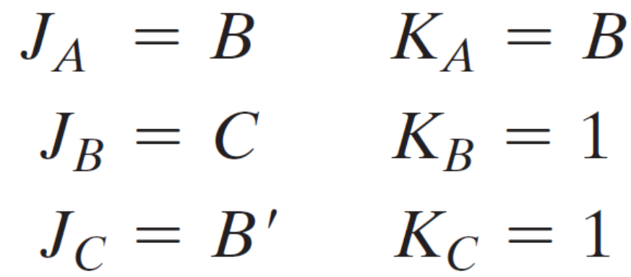
Counter with Unused States
Treat Unused States as ‘X’ while simplifying F/F I/ps in K map

Slide 51
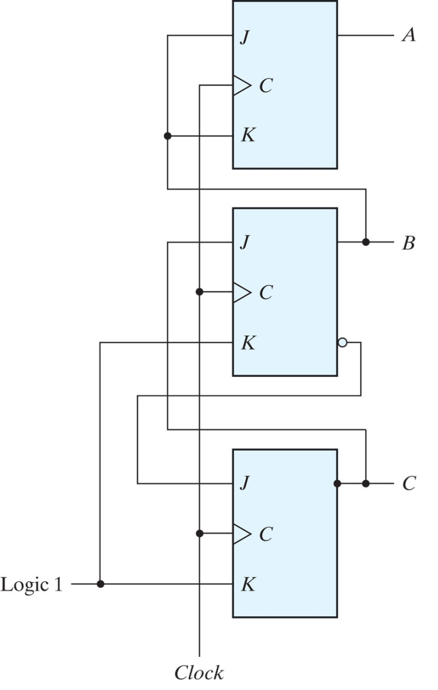

Counter with Unused States
000
001
110
010
101
100
Two Unused States:
011
111

Slide 52

Counter with Unused States

Slide 53
Counter with Unused States (Startegy – II)
Add Unused states in State Table and
Direct them (forcefully) to any used state
0 1 1 ? ? ?
1 1 1 ? ? ?

Slide 54
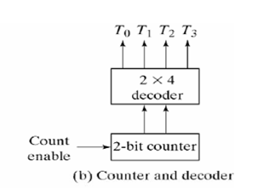
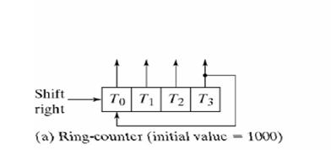
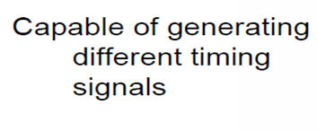
Ring Counter
CLK
T₀
T₁
T₂
T₃

